Slide 1
Supporting Language and Communication
Emma Berry
Schools Link Speech and Language Therapist
The Balanced System and the link therapy role
What is SLCN? & how can we spot it?
To understand what school is doing to support your child’s communication
To understand what you are already doing to support your child’s communication
To have new ideas of how to further support your child’s communication

Slide 2
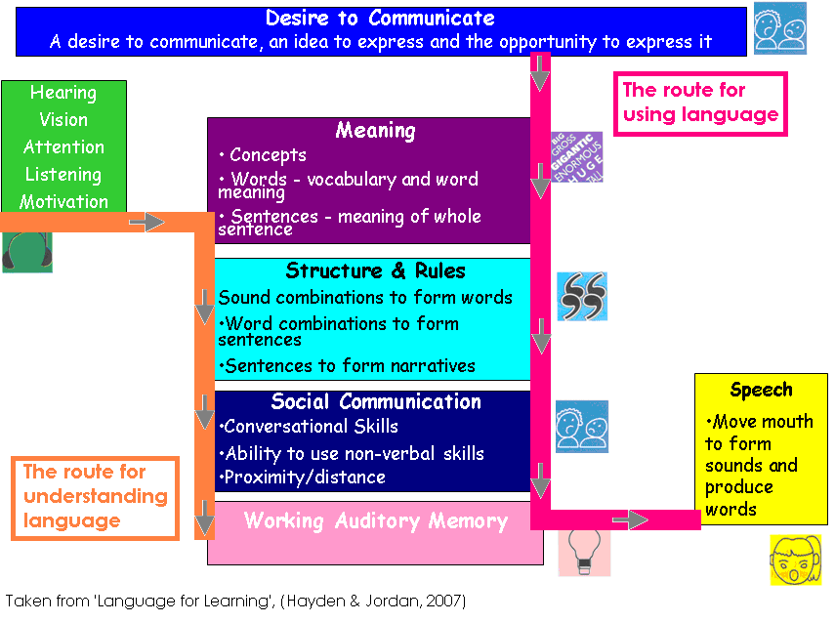
Notes:
This is just an overview and a basic model of speech, language and communication skills.
The language for Learning Model
For any person to complete a task it requires a multiple number of skills to happen all at the same time.
Have an idea to express and the opportunity to express it = social communication skills. Over riding desire to communicate with other people. Our desire to communicate ranges – we communicate for a range of social purposes, not just to meet our own personal needs. For some children this is the first stumbling block.
The ability to understand and use concepts, words and sentences. we need to understand the words that are being said and the sentences that these words are in. This is the vocabulary store or semantic system which stores word meanings, associations and links words together by category. We learn new words by storing them in our mental filling system- by making links to other words and world knowledge we have.
Language is governed by rules and is structured in a specific way. Skills in this area include:
Phonology – the speech sound storage system; rules governing how sounds are combined to form words. Morphology – changes to the beginnings and endings of words to alter the meaning for instance walk -> walking -> walked -> walks. But irregular drink – drank-
Syntax – the way in which words are combined to form sentences the word order rules.;. So were trying not to speak like yoda. .The way in which we string sentences together to form sequenced narrative.
Social communication skills again: conversational skills; nonverbal skills (gesture and body language, facial expression, posture, fillers ummmm ahhhh )
Speech – the ability to co-ordinate the mouth to produce the sounds needed to make words
working auditory memory – the ability to remember information for long enough to process it and understand the meaning. Also allows speakers to remember what has been said and what still needs to be said
attention and listening – the ability to hear what someone has said, see the non-verbal clues or body language used, attend to the speaker and be interested in what the speaker has to say.
This is just an overview and a basic model of speech, language and communication skills.
The language for Learning Model
For any person to complete a task it requires a multiple number of skills to happen all at the same time.
Firstly, the child needs an over riding desire to communicate with other people. A fundamental skill that we often assume will be present. Our desire to communicate ranges – we communicate for a range of social purposes, not just to meet our own personal needs. For some children this is the first stumbling block.
Next, they need to be able to attend and listen which allows them to hear what is being said.
Thirdly we need to understand the words that are being said and the sentences that these words are in. We need a store of words, a vocabulary and to understand what these words mean. Give an example of a key word and our shared understanding of what that word means. E.g table.
Structure – we need to understand and be able to use the right structure – all languages are governed by rules and are structured in specific ways. This helps us to organise our language so it can make sense.
Our rules include: phonology the ways in which sounds can be combined to form words
Syntax the ways in which words can be ordered and changed to form sentences (morphology)
The way in which we string sentences together to form narrative.
Social communication – we need to know to use these language skills in conversations – how to take turns, maintain a conversation
Working memory – remember what has been said
Speech – co-ordinate our mouths to produce the correct sounds.
ACTIVITY – what did you have for breakfast?
So by using a colour coding system we can visualise these fleeting words/ concepts and instructions in the understanding the meaning of words box, structure and rules and this all helps with working memory as well.

Slide 3
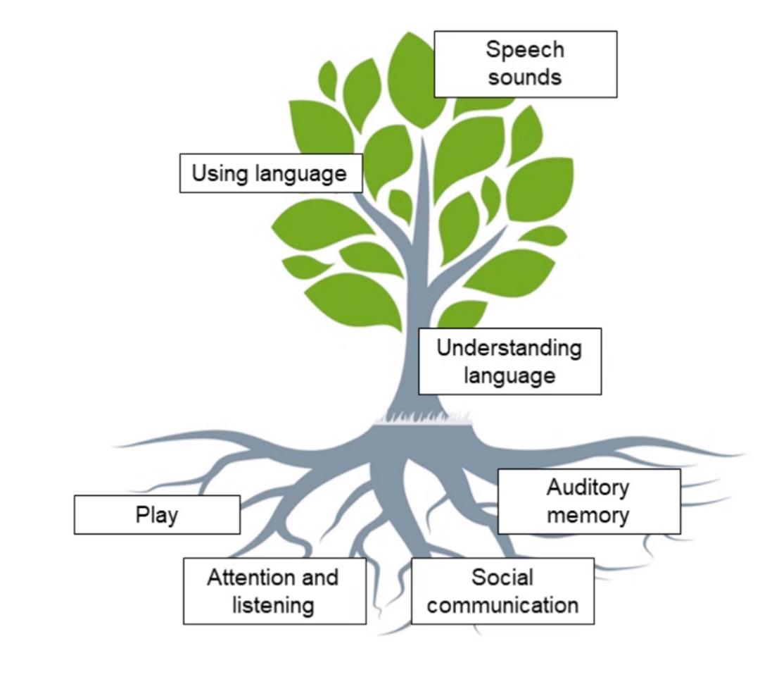

Notes:
When developing language, children go through the same stages; some will be quicker, others a little slower, but all should have reached certain stages by certain times.
= the basic communication tree. It represents the speech, language and communication development in children. The tree has roots, a trunk and branches that represent the foundations, the understanding and use of language respectively. Children develop different areas of communication at different rates but a strong foundation (the roots) of the fundamentals of communication will support the rest of the tree’s growth.

Slide 4



Speech, Language and Communication Needs (SLCN)
Speech | Language | Communication
Saying sounds accurately and in the right places in words Stammering. Hesitating, or prolonging or repeating words or sounds Speaking with expression with a clear voice, using pitch, volume and intonation to support meaning | Learning and using new vocabulary Using words to build up sentences, sentences to build up conversations and longer stretches of spoken language Putting information in the right order to make sense Understanding and making sense of what people say | Language used to represent concepts and thoughts Using language in different ways: question, clarify, describe Non-verbal rules of communication: being able to listen to others, take turns and stick to a topic Being able to talk to people outside of our comfort zone
Notes:
sentence-trouble.1294933642.pdf
SPEECH:
making different speech sounds, this makes it hard for others to understand what they are sharing
stammering or stuttering, where sounds or words are repeated or may be difficult to produce without effort;
a persistently harsh or unusual voice quality
LANGUAGE:
learning new vocabulary
finding the right word to say
using age appropriate sentence structures
linking sentences with words such as ‘and’, ‘but’, ‘so’
telling stories
understanding complex sentences
understanding idioms/ figures of speech
COMMUNICATION
face watching
turn taking, sharing, ending conversations
reading body language
staying on topic
using language to negotiate in conversations or arguments
talking to people outside of their comfort zone, in different enviroments
People with speech, language and communication needs (SLCN) have difficulties in communicating with others. This may be because they cannot say what they want to, they have difficulty understanding what is being said to them.
For some this may be minor and temporary whilst for others their needs will be complex and long-term.

Slide 5

Interactions with a more talkative child
Child leads the play, brings their own ideas
Adult responds to the child and takes turns to talk
Child starts conversations
Feels two-way
Child’s speech intelligible
People feel relaxed, confident, involved, animated etc.
Child asks questions

Slide 6

Interactions with a less talkative child
Adult leads the play and takes more turns
Child responds to the adult (sometimes!)
Adult starts the conversations and defaults to asking more questions
Speech unintelligble
Long pauses in response to any questions - becomes disjointed
People feel uncomfortable, awkward, under pressure etc.
Child might feel anxious, worried, on the spot etc.

Slide 7
The Impact of SLCN:
Good communication skills are linked to achievement and life chances. They are fundamental to every aspect of our lives affecting attainment, learning, literacy, social relationships, behaviour, mental health and ultimately employment and social mobility.
Around 25% of children starting school across the UK have poorly developed speech or language skills. It is the most common type of primary special educational need and the second most common type of need identified for pupils with Education Health and Care Plans (EHCPs) according to Government figures.
It has long been known that without the right support, pupils with SLCN risk a range of poor life outcomes.
Law et al (2017) highlight: “Children with language difficulties at age five were four times more likely to have reading difficulties in adulthood, three times as likely to have mental health problems, and twice as likely to be unemployed when they reached adulthood.”
From Speech and Language Link - Speech and Language in School - Speech and Language Link

Slide 8

How schools are supporting:
Visuals – symbols
Language Through Colour
Intensive Interaction
Adult-Child Interaction Play Based Therapy
Speech LINK
Language LINK
Makaton
Cued articulation
pre teaching of vocabulary ++many more...

Slide 9
Parental support
Early Intervention – spotting the signs and asking for help
Interactive play – reduce excessive screen time and focus on interactive communication, talking, reading together, singing, and story telling, or playing board games.
‘serve and return’ – make sure you respond to your child’s communication; show them you are listening and are interested in what they have to say

Slide 10
Strategies for Attention and Listening:
Schedule regular ‘special time’ – which is 1:1 with no distractions
Get down to the child’s level
Face the child directly
Wait for eye contact/ face watching
Allow extra silence
Follow the child’s lead during interaction
Use visual supports to explain things clearly- drawings, pictures, objects

Slide 11
Strategies for Language:
Break down instructions into smaller steps
Avoid ambiguous language, such as idioms or expressions
Check understanding by asking them to tell you in their own words
Show what you mean using objects, pictures, drawings
Give extra time for them to respond……… silence is okay
Pick one brand new word to focus on all day and use it often
Repeat what your child says, correcting grammar naturally as you do
Try to reduce your questions and use comments instead

Slide 12
Strategies for speech:
Reduce background noise – turn of the TV and the radio to minimise distraction and help the child focus on speech
Positioning – sit opposite them, let them see your face and mouth and body language
Pacing – speak more slowly and calmly allowing the child time to process what you are saying
Simplify – use simple language and short sentences, don’t overwhelm
Model the correct pronunciation DON’T CORRECT! – repeat back what they have said, e.g., if the child says ‘tat’ you reply, ‘Yes, that is a nice cat’

Slide 13
Fun activities:
Sharing books, talk about the pictures
Singing songs, - helps with rhyme, rhythms, vocabulary e.g. heads shoulders knees & toes, here we go round the mulberry brush, row row row the boat.
eye spy –
Simon says
category naming e.g. animals, food etc,
What am I?
ABCD - I went to the shop and bought a… apple, banana, cat etc..
Physical turn taking games e.g. roll the ball, kick the ball etc
Fun games:

Slide 14
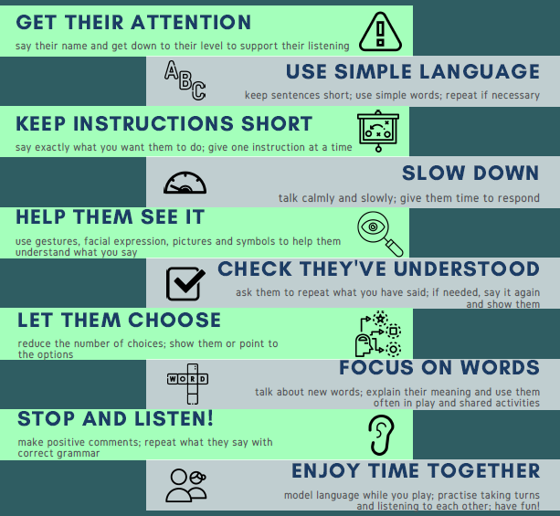
Top tips:

Slide 15
Useful websites:
- BBC Tiny Happy People
- Speech Link Parent Portal
- Speech and Language UK
- The National Literacy Trust - Words for Life
- The Pod – KCHFT (ignore referral information)

Slide 16


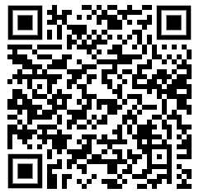


Children’s Therapies
The Pod
https://www.kentcht.nhs.uk/service/childrens-therapies-2/

